Slide 1


Stochastic On Time Arrival Problem (Deterministic Approach - Dijkstra)
Project Milestone - 03
Abdulwahab Shaikh - AU2440099
Vruddhi Madam - AU2440137
CSE 400: Fundamentals of Probability in Computing

Slide 2
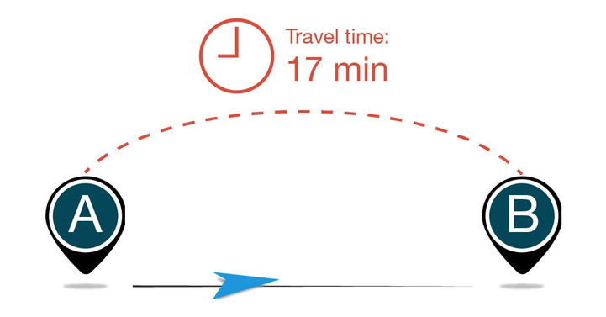
In Previous Milestones (1 and 2)
Stochastic On Time Arrival
Travel time is stochastic and a Random Variable
Objective: maximize P(T≤D)
Network modeled as graph G(V,E)
Jensen’s Inequality performed on the model

Slide 3
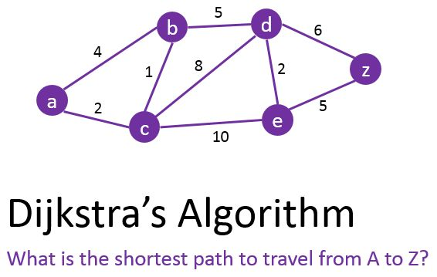
Goal
To build the model with a deterministic approach
Finding the shortest path in a given network of nodes for Milestone - 03

Slide 4
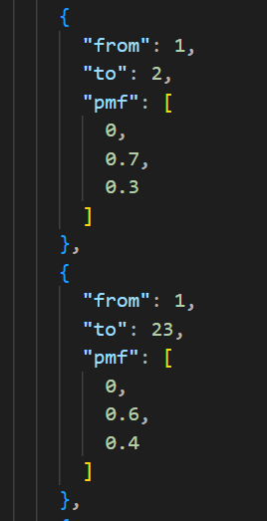
Deterministic Approach
Each road is considered as an edge and it has
Source
Destination
The PMF for arriving within 0, 1 and 2 seconds respectively
We are using a medium sample of around 500 Nodes from the data generated randomly

Slide 5

Dijkstra / Least Expected Travel Time (LET)
This time the deterministic algorithm is Dijkstra
We follow the concept of LET
Least Expected Travel Time between 2 distinct nodes
Lack of Randomness and works purely on comparison

Slide 6
Dijkstra with Waypoint Navigation
Stop-2
Stop-1
We can also add in multiple stops for our chosen path
The algorithm break down the process in multiple pipelines
Uses Dijkstra on multiple paths recursively untill finding the shortest path for all
Merging the different piece of pipeline

Slide 7
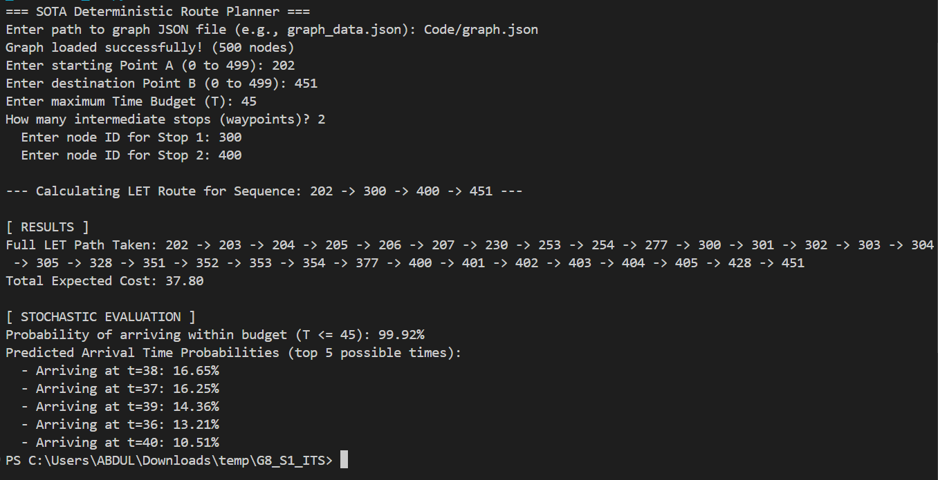
The Results of the Algorithm - 1
Graph takes an input file (.json) format of a dataset of the nodes with PMF of reaching different destinations from 1 node to other and the PMF of different seconds
Holds the Number of nodes and asks destination and source

Slide 8
The Results of the Algorithm - 2
After calculation and the merge part of the different pipelines, it gives the final resultant path as output sequence of ordered nodes
The code also calculates the top 5 possible arriving times and their probability

Slide 9
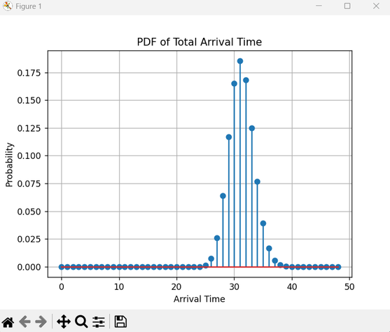
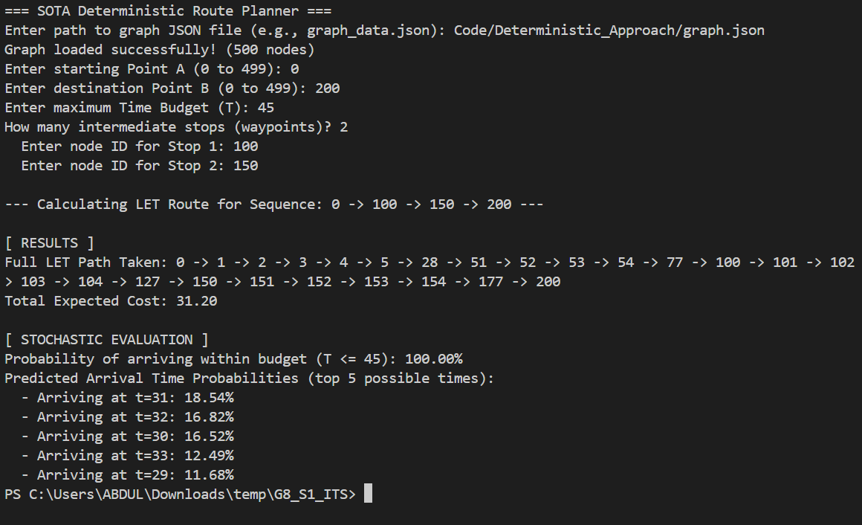
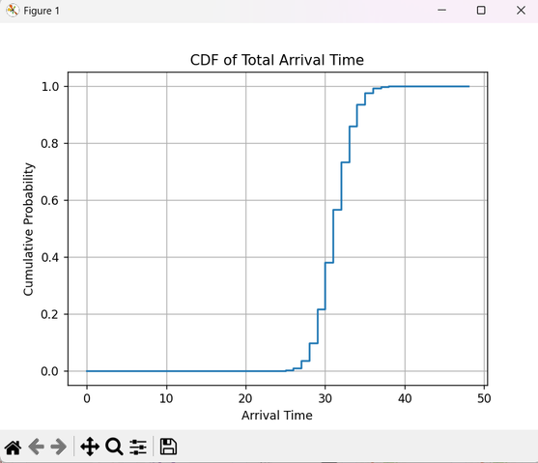
The Results of the Algorithm - 3

Slide 10
Simulation Pipeline
Network on the roads created using about 500 nodes.
Each of the edges contains a PMF of travel time.
Variable: The graph is based on the using of JSON dataset.
Deterministic routing is done through the Dijkstra algorithm.
Shortest path computed using by expected travel time.
Dataset (JSON)
Graph Construction
Dijkstra Algorithm
Shortest Path
Reliability Analysis

Slide 11
Least Expected Travel Time (LET)
Every edge has a travel time distribution.
Expected travel time that is calculated as:
E[T] = ∑t∙P(t)
Dijkstra algorithm minimizes the total expected travel time.
This gives deterministic base of routing decisions.

Slide 12
Arrival Probability Computation
At any rate, the journey times are stochastic.
Edge PMFs are combined using convolution.
PMFₚₐₜₕ = PMF₁ * PMF₂*.....* PMFₙ
The probability of arrival is calculated to be
P(T ≤ D)
Shows probability of reaching the destination ahead of time.

Slide 13
Observations
Dijkstra determines the one that takes the shortest time.
The most likely arrival time is demonstrated by the PDF.
The CDF is characterized by the probability of arriving within time budget.
Reliability will depend on complete allocation of travel time.

Slide 14
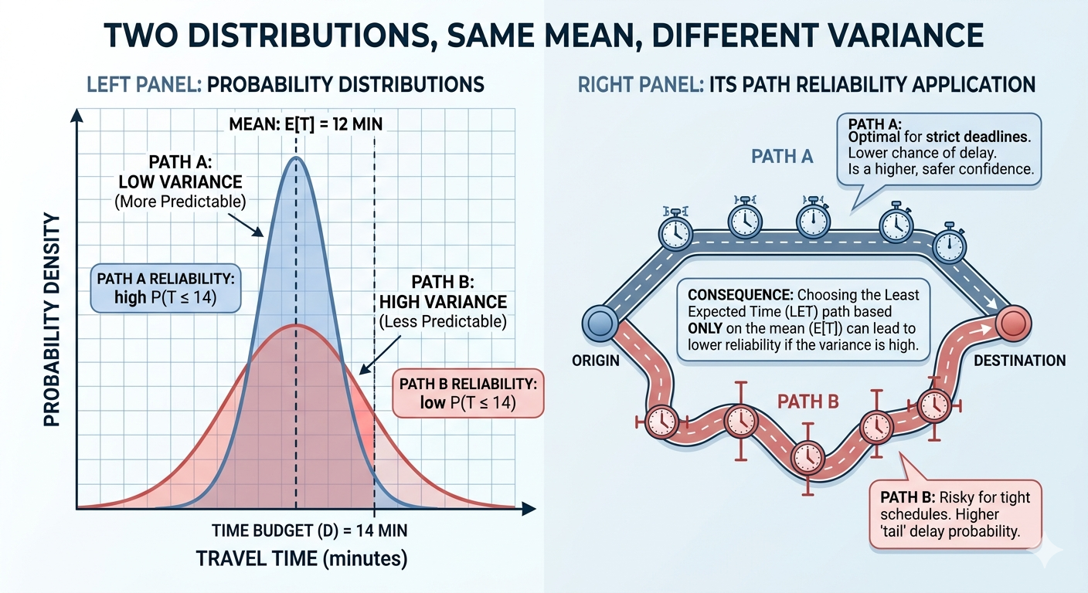
Limitations
Only expected time is minimized.
Variability in the travel times is not taken into consideration.
Possibly, there can be differing reliabilities in paths with the same expectation.
These deficiencies will drive the use of stochastic or randomised routing approaches.

Slide 15
References and Source
Niknami, M. and Samaranayake, S. (2016). Tractable Pathfinding for the Stochastic on-time Arrival Problem. In: Springer. pp.231–245.
GitHub Repositroy link for the Deterministic Dijkstra Simulation

